Slide 1
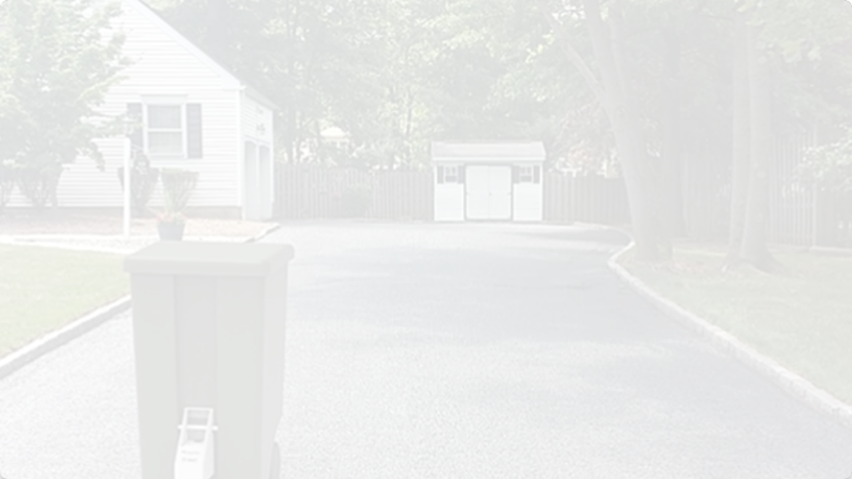

THE AUTONOMOUS
GARBAGE CAN
Group 4: 4A03 Engineering & Management
Isaac Hammer, Luca Namestnik, Carson Crysler, Matthew Rakic, James Cameron

Slide 2
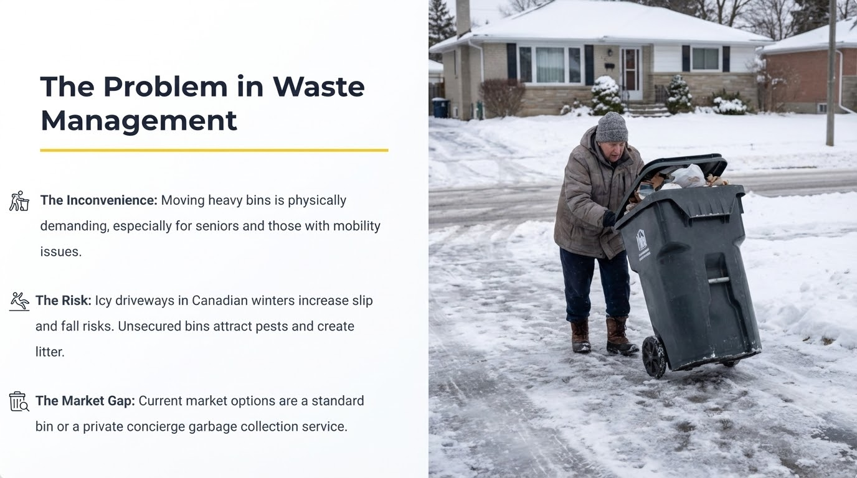

Slide 3

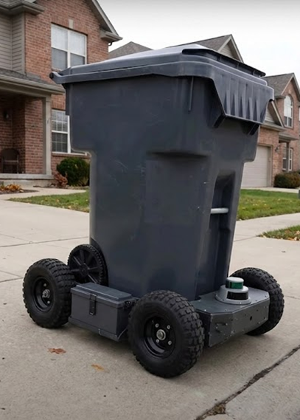

Solution
Autonomous: Self-drives from garage to curb on a set schedule.
Smart Return: Detects when emptied and automatically returns to the charging dock.
Winter Ready: High-traction wheels and sealed electronics for Canadian climates.
Image generated by Google Gemini

Slide 4






Value Proposition
Convenience
Safety & Accessibility
Cost Efficiency
"Set it and forget it."
Reduced Risk.
One-Time Purchase.
Eliminates the weekly chore and arguments over whose turn it is. Never miss a pickup day again.
Prevents slip-and-fall injuries on icy driveways. Critical for seniors and those with limited mobility.
Provides the luxury of a concierge service without the expensive recurring monthly fees.

Slide 5







Market Opportunity
TAM
(Total Addressable Market)
SAM
(Serviceable Available Market)
SOM
(Serviceable Obtainable Market)
$6.95 Billion
$1.74 Billion
$26 Million
9.27M Canadian detached homes
2.32M "Smart Home" adopters
35,000 units over 5 years
The Smart Bin market is growing at a 12.4% CAGR.

Slide 6






Target Customers
Seniors & Mobility Limited
Tech Adopters
Busy Families
Value: Automation.
Value: Time Savings.
Value: Safety & Independence.
Integrates with the smart home ecosystem for "set it and forget it" convenience.
Eliminates the weekly chore and arguments over whose turn it is.
Prevents injury on icy driveways and eliminates heavy lifting.

Slide 7
Competitive Landscape: Blue Ocean Strategy
Feature | Standard Bins (Rubbermaid) | Concierge Service | Our Product
Cost Model | Low One-Time | High Recurring | Mid One-Time
Automation | None (Manual) | Full (Human) | Full (Robotic)
Route Memory | N/A | N/A | Taught Waypoints
Winter Safety | Low (User Risk) | High | High

Slide 8













Technology
Ultrasonic/ToF and Bumper Sensors
BLE Module
Mobile App Setup
Obstacle Detection
STM32 MCU
9-DoF IMU
Central Control Unit
Motor Drivers
Navigation
Locomotion
Path Planning & Logic
Wheel Encoder
LiFePO4 Battery
Speed and Distance
Cold Weather Power

Slide 9

Financial Viability
NPV (5-Year): $12.2 Million CAD.
Break-Even: Year 3 (Approx. 0.8 years post-launch).
Investment Need: $300,000 for MVP phase.
ECV: $9.8 Million (Expected Commercial Value).

Slide 10











Risk Management Strategy
Hardware Reliability
Navigation Failure
Supply Chain
High Probability / Impact
Medium Probability / High Impact
Medium Probability / Impact
Risk: Winter corrosion & mechanical failure.
Risk: Sensor obstruction or signal loss.
Risk: Component shortages or delays.

Slide 11

The Ask
Investment Return
$26M Market Access
First-mover advantage in smart waste.
$300k
High Margin IP
Patentable drive pod technology.
Clear Exit Strategy
Acquisition target for major appliance brands.
To execute the 24-week MVP Build

Slide 12

References
-
Gov. of Canada, Statistics Canada, "Estimates of the number of private households by size," 2025.
-
Privacy Commissioner of Canada, "PIPEDA."
-
Grand View Research, "Smart trash bin market size, share & growth report, 2030."
-
Gov. of Canada, Statistics Canada, "Index to the latest information from the Census," 2025.
-
Mordor Intelligence, "Canada Smart Home Market Size & Forecast report 2030."
-
Protolabs, "Cool Idea Award Winner: SmartCan."
-
Environics Research, "Understanding fintech adopters in Canada."
-
K. L. Wilson, "Motorized Garbage Can and Automatic Lid Opener," US Patent 2007/0209846A1, 2007.
-
The Home Depot, "Trash Can Reviews."
-
Justia.com, "Patents Assigned to Simplehuman LLC."
-
LinkedIn, "Cleanrobotics."
-
CSA Group, "Electrical Safety Standards for Consumer Products."
-
Uline, "Toter Bear Tough Trash Cans."
-
CSA Group, "Testing and Certification for Batteries."
-
Verhagen Leiden, "Electric Tow Tug V-move L."
-
ISED Canada, "Radio Standards Specifications (RSS)."
-
Willco Sales, "Waste Caddy Automated Trash Haulers."

